Slide 1

ToBeNamed [v0.3] tutorial
Component-Oriented, Event-Driven Software Architecture for Dynamically Reconfigurable, Concurrent Applications

Slide 2

What is TBN?
Architecture for concurrent software
  Services running in parallel
  Configurable degree of parallelism
Component oriented
  Services are encapsulated into components
Event driven
  Services interact through events
Dynamically reconfigurable
  Services and service interactions can be reorganized/updated at runtime

Slide 3
Overview
Software is organized into components
Components interact only through asynchronous events
Components subscribe to and publish events into named channels

Slide 4
Components
A component instance is an object that consists of:
  Local/internal state variables
  A set of event handlers accessing the local state and/or triggering new events
  start/stop/init methods
  internal methods
Components are not singletons
Component instances are created, managed and destroyed by component factories

Slide 5
Component Factories
A component factory exists for each component type
A component factory is a registry of component instances of a certain type
Each component instance has a unique name within the factory
The factory creates, indexes and destroys component instances by name

Slide 6
Component Factories
Component factories have globally unique names
Component instances have globally unique names of the form: <FactoryName>:<InstanceName>

Slide 7
Events
An event instance is an object
An event instance has
  attributes
  a type
  a priority level (low, medium, high)
An event instance is created when a component event handler raises an event
The event is published into a Channel

Slide 8
Channels
A channel is a communication link between components
Events triggered by components are published into channels
Component instances subscribe their event handlers to channels
A channel “carries” a specified set of event types
Channels have globally unique names

Slide 9
Channels
Every component subscribed to one channel receives the events published in that channel in the same order in which they were published
Channels are FIFO

Slide 10
Event Handlers
An event handler is a component method that accepts events of a certain type
Event handlers execute atomically with respect to other event handlers of the same component instance
An event handler can be subscribed to a channel that carries the same event type (or a subtype) that the handler accepts

Slide 11
Execution
Components are passive (they don’t have threads of their own)
Event handlers are executed by a pool of worker threads shared by all components
When an event handler terminates, all events triggered during its execution are handed over to the workers for execution

Slide 12
Parallel Execution
Different component instances can execute event handlers in parallel
One component instance can only execute one event handler at a time
Events raised by an event handler are not executed before the raising event handler finishes executing (to reflect event causality in execution)
Causal events are executed sequentially

Slide 13
Guarded Event Handlers
Event handlers can have associated guards
A guard is a boolean condition on the component variables
If the condition evaluates to true the handler is executed
Otherwise, the event is enqueued in a handler queue

Slide 14
Guarded Event Handlers
When an event handler terminates, guards are re-evaluated for all guarded handlers with non-empty queues
If upon re-evaluation the condition for an event handler is true, the queued events are executed

Slide 15
Architecture Description Language
Architecture specified declaratively in XML
TBN SystemBuilder parses architecture description and starts the system
ADL specification contains:
  Factories (factory name, factory class)
  Components (factory name, component name
  [, init file])
  Channels (channel name, event class)
  Subscription (component name, channel name, handler name)
  Bindings (component name, event class, channel name)

Slide 16
Reconfiguration
Add/remove components on the fly
Change event subscriptions and bindings
Add interceptor/filter components to transform/preprocess events
Reconfigure components without losing events

Slide 17
Component LifeCycle
Components can be in one of two states: active (running) or passive (stopped)
A component can be reconfigured only if it is passive
A component cannot execute events while in the passive state
Events with passive subscriber components should not be lost…

Slide 18
Channel LifeCycle
… when a component is stopped, all its incoming channels have to be stopped first
When a channel is stopped (passive) all events published into it are enqueued
When a channel is restarted all enqueued events are orderly delivered to the subscriber components

Slide 19
Reconfiguration commands
create/destroy factory
create/destroy component
create/destroy channel
start/stop component
start/stop channel
(un)subscribe component to (from) channel
(un)bind component to (from) channel

Slide 20
Programming with TBN
Write system structure in ADL
Write component classes:
  implement event handlers
Write one class per event type
Write a main program that starts the TBN system builder and reconfiguration server

Slide 21
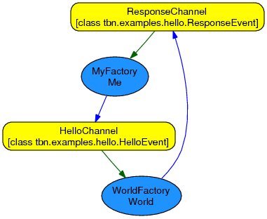
Hello World!

Slide 22
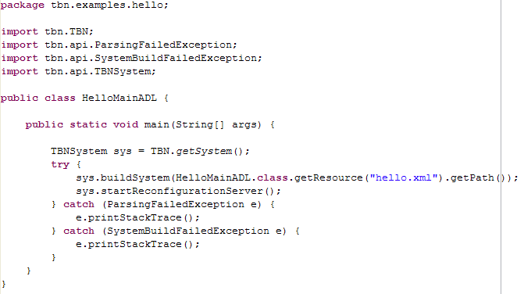
Main program example

Slide 23
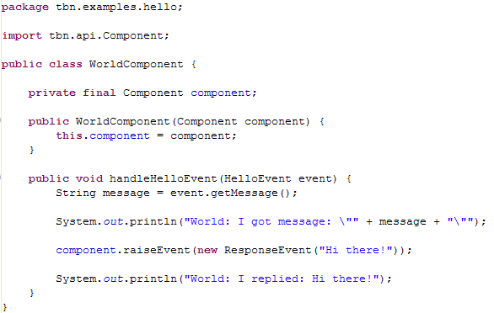
Component Example

Slide 24
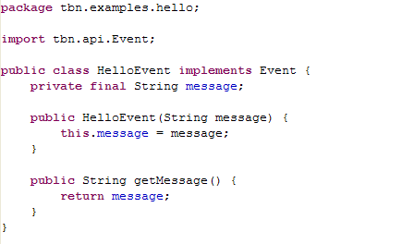
Event Example

Slide 25
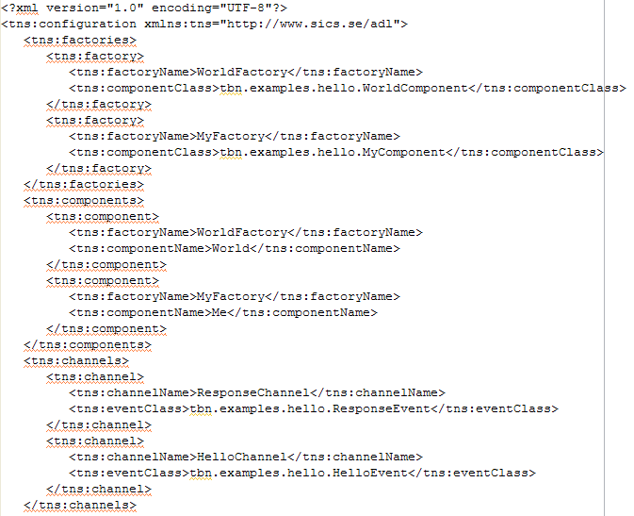
ADL Example

Slide 26
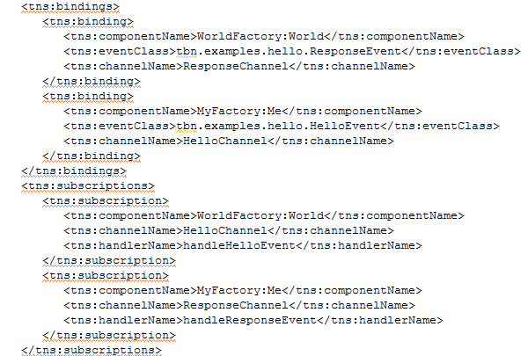

Slide 27
Non-TBN software linking
Components can have internal threads
Foreign services are encapsulated into components and have to be wrapped into an event based (request/response) interface
They can use component internal threads if needed

Slide 28
Communication Component
Define messages by extending the MessageEvent class
Use MessageHandler to send a message to another process identified by its NodeReference
A NodeReference is a triple
  Numeirc identifier
  IP address
  Port number
Handle your message events

Slide 29
Timer Component
Use TimerHandler to start or cancel a timer
Handle TimerExpiredEvent

Slide 30
Thank you!
More Questions?

